Slide 1


SIMATS ENGINEERING Saveetha Institute of Medical and Technical Sciences Chennai-602105.
Advanced Computer Vision Framework For Crop Disease Detection, Classification, And Precision Agricultural Analysis
ITA0502-COMPUTER VISION
Presented by
Konjeti Pavan Deekshith (192412172)
V Sunil Kumar(192425292)
M Yasodha Krishna(192472100)
Faculty:
Mrs . R C Jeni Gracia, AP / CSE
Program Director :
Dr. Sasi Rekha, Prof/CSE

Slide 2
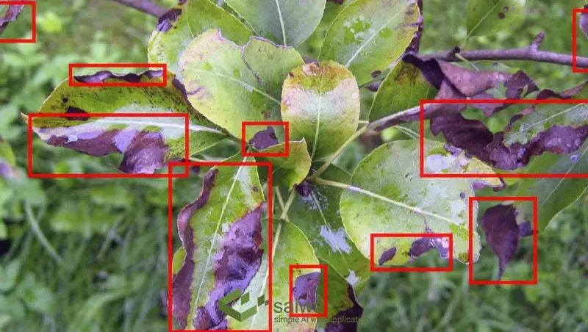
Agenda
Project Overview (What this project does): Builds an computer vision and deep learning system that analyzes plant leaf images to instantly detect, classify, and localize agricultural crop diseases, helping farmers take early preventive measures.

Slide 3
INTRODUCTION
Agriculture is a foundational sector supporting global food production and economic stability. However, plant diseases significantly threaten crop yields and product quality.
Traditional manual inspection methods rely heavily on human visual judgment, making them subjective, slow, and prone to error.
With recent advancements in Computer Vision and image processing, it is now possible to automatically capture, process, and analyze plant leaf imagery to diagnose diseases with high precision.
This project leverages advanced computer vision pipelines and deep learning architectures to instantly detect, classify, and localize agricultural pathologies from visual data.

Slide 4
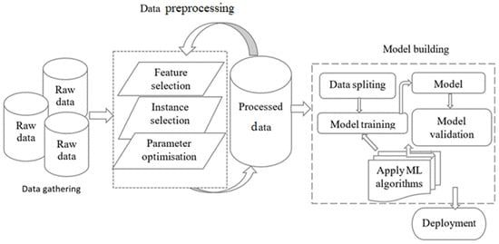
Objectives
Build an automated computer vision framework to identify crop leaf diseases early and minimize yield loss.
Train deep learning object detection and classification models on rich agricultural image repositories (e.g., Plant Village).
Replace subjective manual inspections with rapid, reliable computer algorithms.
Provide a clear user interface and visual heatmaps/bounding boxes to assist users without specialized expert knowledge.

Slide 5
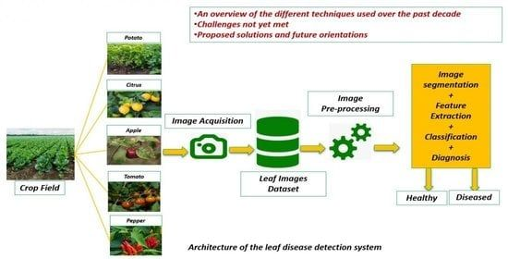
PROBLEM IDENTIFICATION AND ANALYSIS
Crop diseases lead to severe harvest reductions and critical economic losses for farming communities worldwide.
Delayed identification allows pathogens to spread rapidly across fields before corrective interventions can be deployed.
Manual tracking requires expert agronomist intervention, which is scarce and expensive.
The Need: An automated, computer vision-driven diagnostic system that analyzes visual leaf patterns to spot anomalies instantly, localizes infection zones, and delivers prompt diagnostic results.

Slide 6
LITERATURE REVIEW
Year | Author / Study Focus | Techniques Used | Dataset Type | Key Findings | Limitations
2022 | Image-based Disease Classification | SVM, Random Forest | Leaf image datasets | Improved classification using texture & color features | Time-consuming preprocessing
2023 | Deep Learning for Crop Disease Detection | CNN, VGG16 | Large image datasets | High accuracy, automatic feature extraction | Requires large datasets, high computation
2024 | Advanced Deep Learning Models | ResNet, DenseNet, Transfer Learning | High-resolution plant images | Very high accuracy, robust performance | Complex models, expensive hardware
2025 | AI-based Smart Agriculture Systems | CNN + IoT + Hybrid Models | Image + Sensor data | Real-time detection, smart farming solutions | Complex implementation, cost

Slide 7
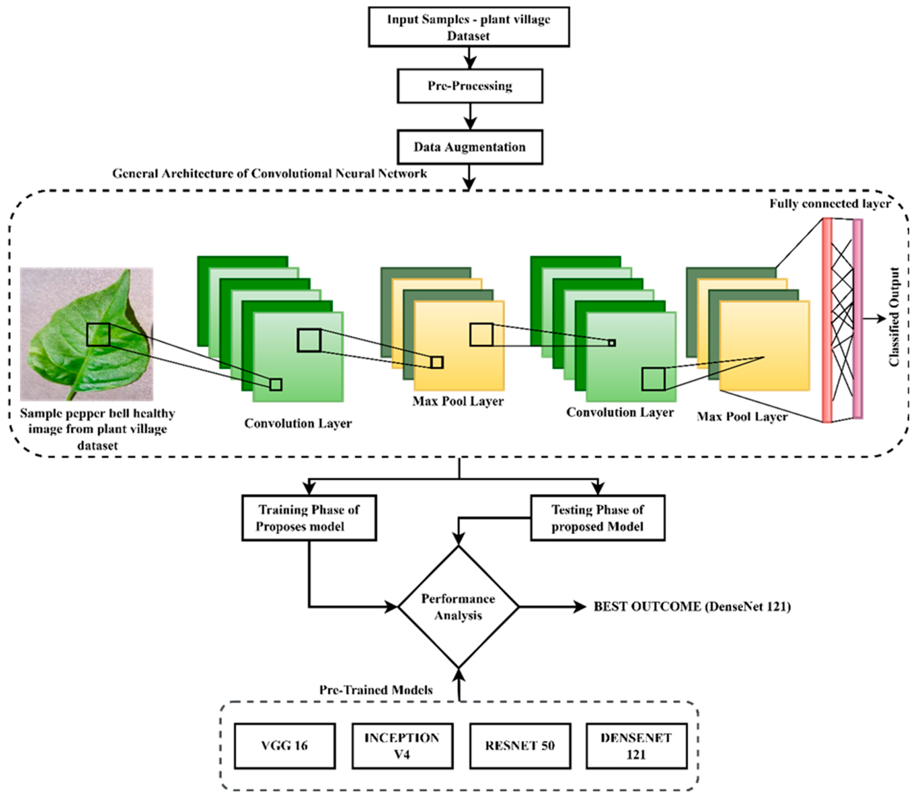
SYSTEM ARCHITECTURE

Slide 8
MODULE 1: Image Acquisition and Preprocessing
Image Capture: Gathering raw leaf and crop images from agricultural datasets or live field cameras.
Resizing & Standardization: Uniform scaling of image resolutions to match network constraints.
Data Augmentation & Cleaning: Randomizing orientations, adjusting lighting profiles, removing background noise, and normalizing pixel intensities to enhance model generalization.

Slide 9
MODULE 2: Feature Extraction and Computer Vision Models
Architecture Implementation: Utilizing powerful pre-trained models and backbone networks (e.g., DenseNet121, ResNet, YOLO architectures) optimized for spatial feature extraction.
Localization & Bounding: Utilizing grid mapping, anchor boxes, and confidence score assignments to pinpoint precise infection boundaries on plant leaves.

Slide 10
MODULE 3: PREDICTION AND RESULT VISUALIZATION
Inference Generation: Running test samples through the trained computer vision network to classify healthy versus diseased states.
Visual Output & Analytics: Rendering bounding boxes, class probabilities, and diagnostic summaries on a responsive user dashboard to assist with rapid decision-making.

Slide 11
REFERENCES
Kuhn, M., & Johnson, K. (2013). Applied Predictive Modeling. Springer.
Witten, I. H., Frank, E., Hall, M. A., & Pal, C. (2016). Data Mining: Practical Machine Learning Tools and Techniques. Morgan Kaufmann.
R Core Team. (2023). R: A Language and Environment for Statistical Computing. R Foundation for Statistical Computing.
Food and Agriculture Organization (FAO). (2022). Plant Disease Management for Sustainable Agriculture.
Agricultural datasets and crop disease information obtained from Kaggle Agricultural Datasets and other open research sources.

Slide 12


